Slide 1

SELF JOIN
A self join is a join in which a table is joined with itself (which is also called Unary relationships), especially when the table has a FOREIGN KEY which references its own PRIMARY KEY. To join a table itself means that each row of the table is combined with itself and with every other row of the table.
Infoway Technologies, 3rd Floor Commerce Centre, Rambaug Colony, Paud Road Pune 411038

Slide 2
In this example, we referenced to the staffs table twice: one as e for the employees and the other as m for the managers. The join predicate matches employee and manager relationship using the values in the e.empno and m.mgr columns.
The following example the RIGHT OUTER JOIN of two tables T1(AC-1, AC-2, AC-3, AC-4, AC-5) and T2(C-1, C-2, C-3, C-4). The RIGHT JOIN will match rows from the T1 table with the rows from T2 table using patterns:
Infoway Technologies, 3rd Floor Commerce Centre, Rambaug Colony, Paud Road Pune 411038

Slide 3
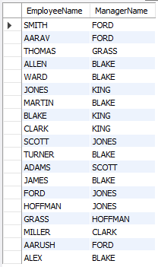
Self Join
syntex
SELECT a.column_name, b.column_name... FROM table1 a, table1 b WHERE a.common_name = b.common_name;
SELECT e.ename EmployeeName, m.ename ManagerName FROM emp m, emp e WHERE m.empno = e.mgr;

